Slide 2
http://epi.publichealth.nc.gov/cd/stds/figures.html

Slide 3
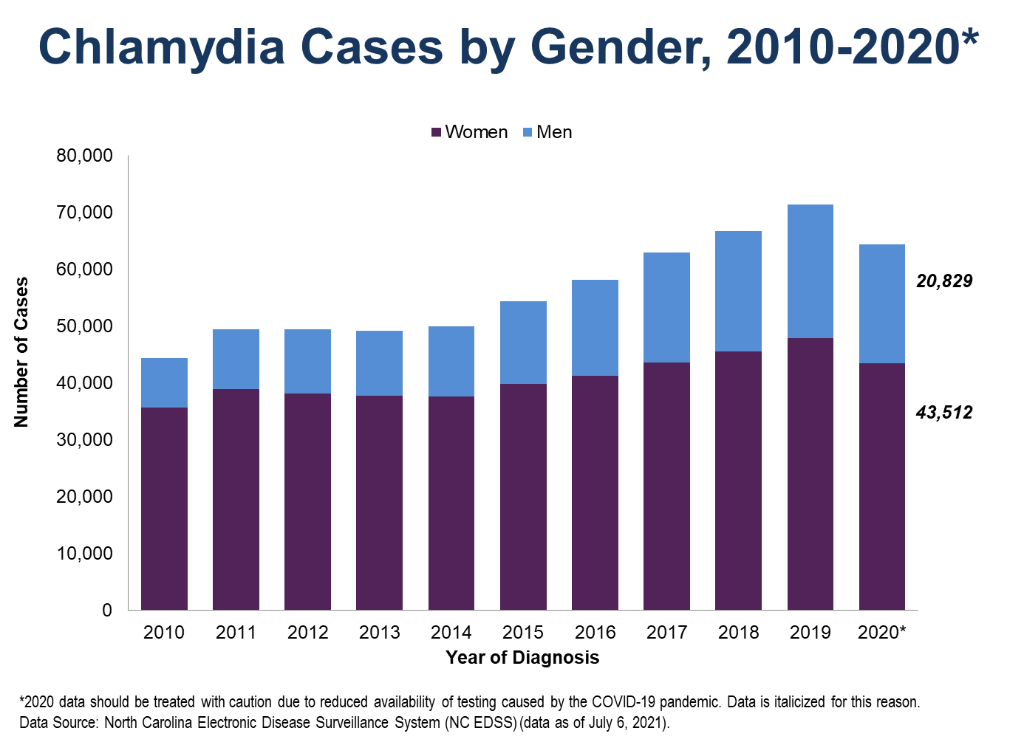

Slide 4
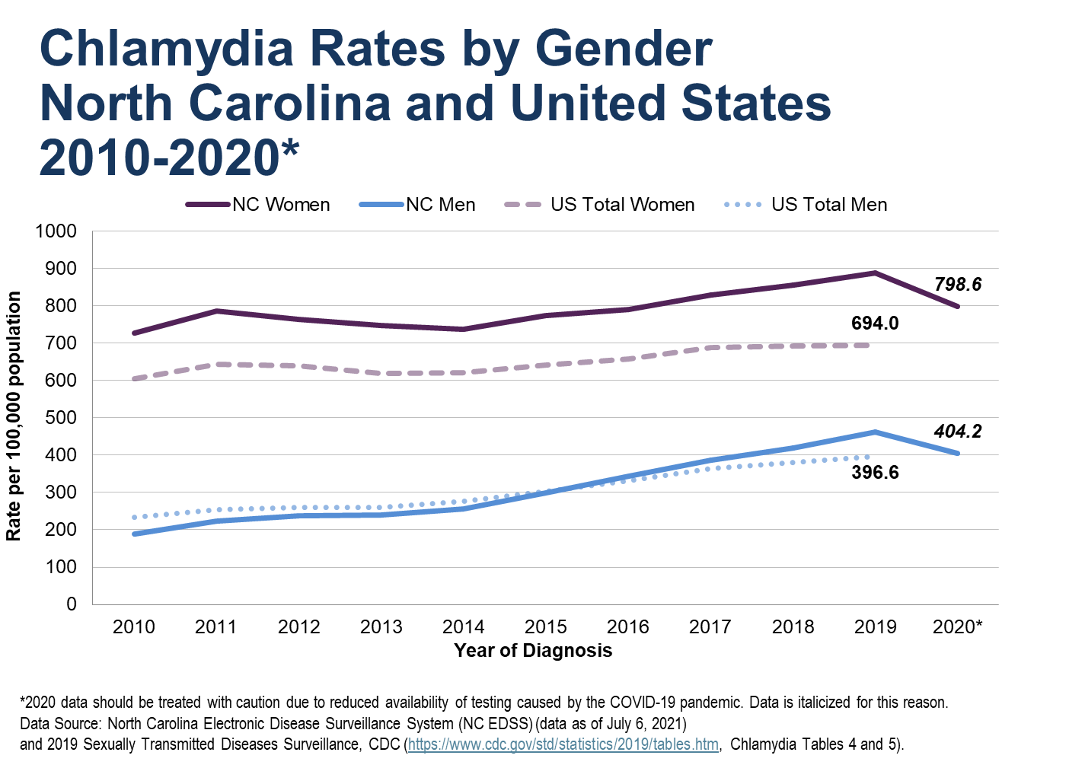

Slide 6
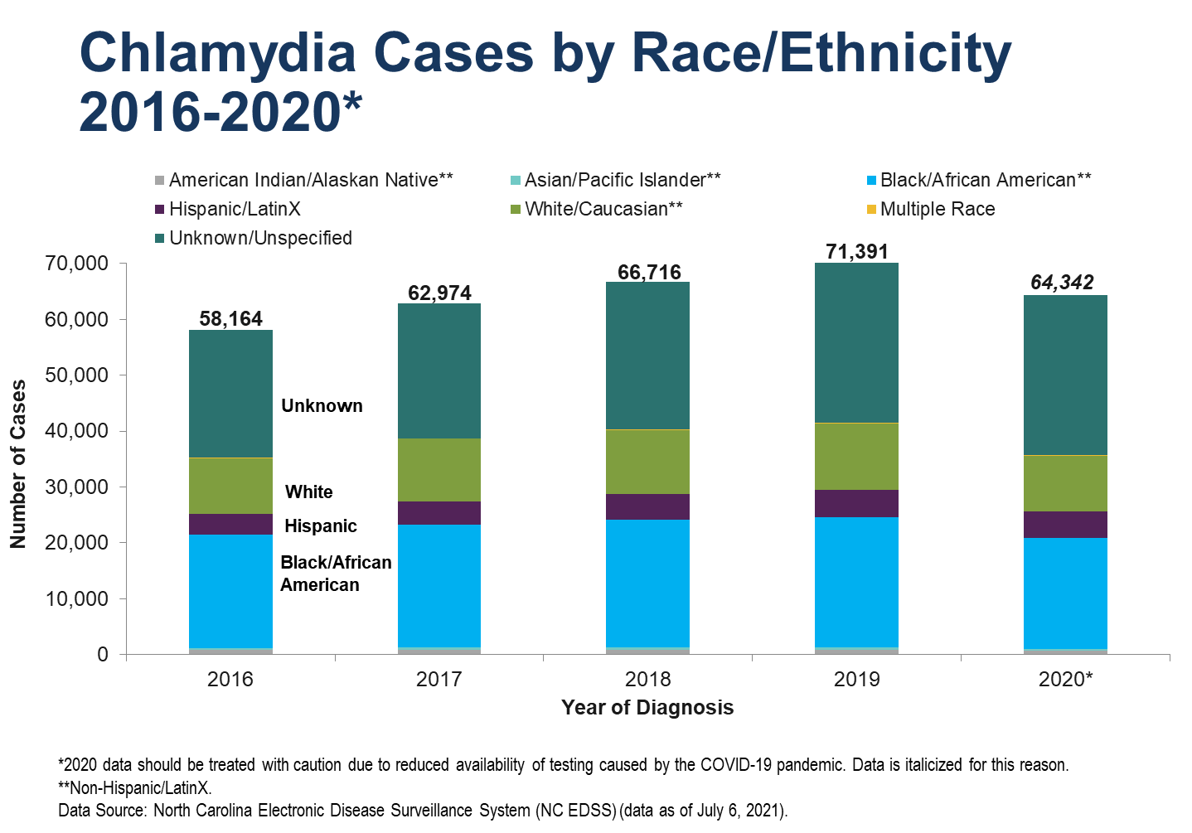

Slide 7
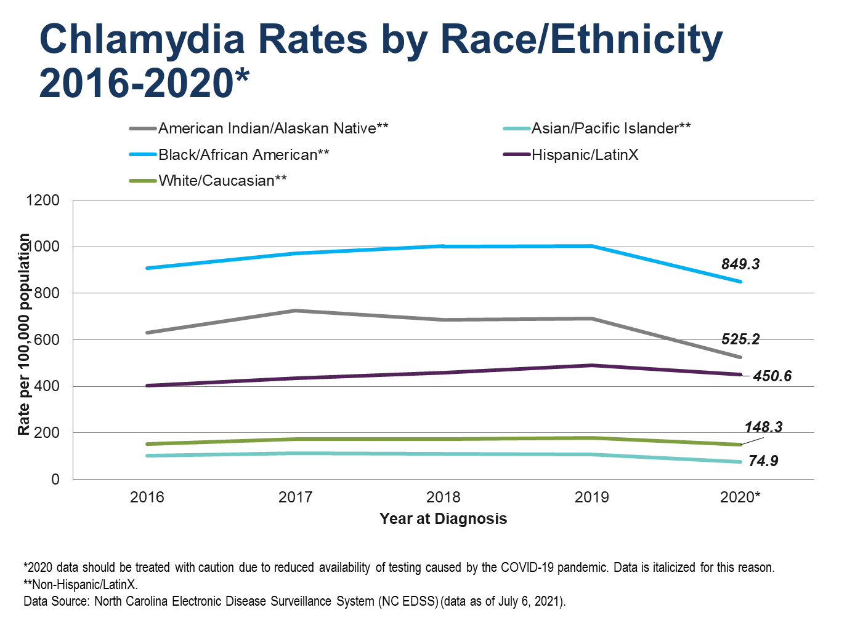

Slide 8
